Slide 1

CAPGEMINI TECHNOLOGY SERVICES INDIA LTD.
PROJECT UNDER DOT NET TRAINING.
UNDER THE GUIDANCE OF
JAMUNA MAHALINGAM

Slide 2
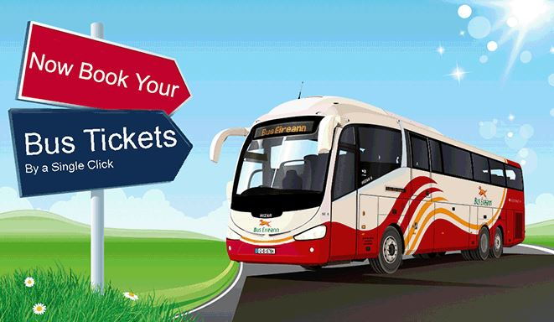
BUS RESERVATION SYSTEM BY- TEAM 2

Slide 3
Our Team Members
ROLE :
Teamlead
UI
API
DB
ROLE :
WEB API
DB
UI
ANKIT GHOSH
JSL PRATHYUSHA
ROLE :
UI
DB
ROLE :
DB
DAL
PREETI SAHA
PRADYUMNA BISWAL
ROLE :
DB
DAL
ROLE :
DAL
DB
ASHA HB
SURAKSHA P
AKANKSHA BANDI
ROLE :
DAL

Slide 4
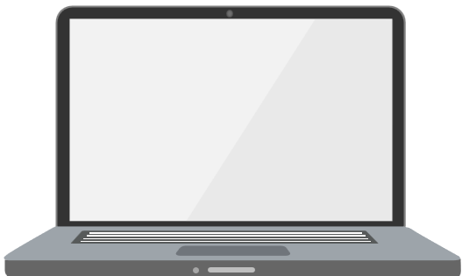
ABOUT OUR PROJECT
Our Project provides :
A portal for bus ticket reservation.
Allows customers to book bus tickets from anywhere and anytime.
Customer can easily book their tickets and cancel tickets at his comfort.
Customer can view all the details of the seats, bus, and route along with picture.
This software computerizes
any traveling company to manage data, so that all the transactions become fast and there should not be any error in transactions like calculation mistake, bill generation and other things.
Modules:
Admin Module
User Module

Slide 5

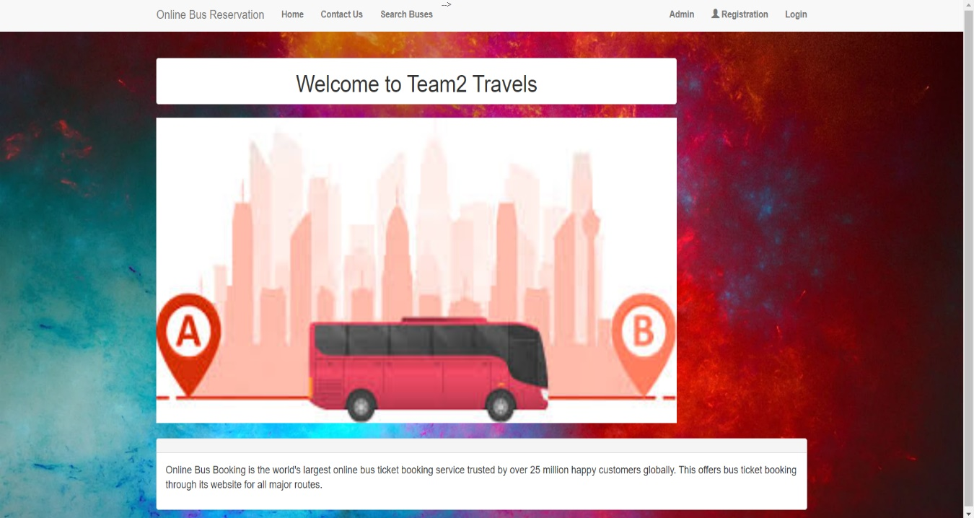
IMAGES OF OUR PROJECT
HOME PAGE
Figure: This is the default home screen page showing the name of the travel agency

Slide 6
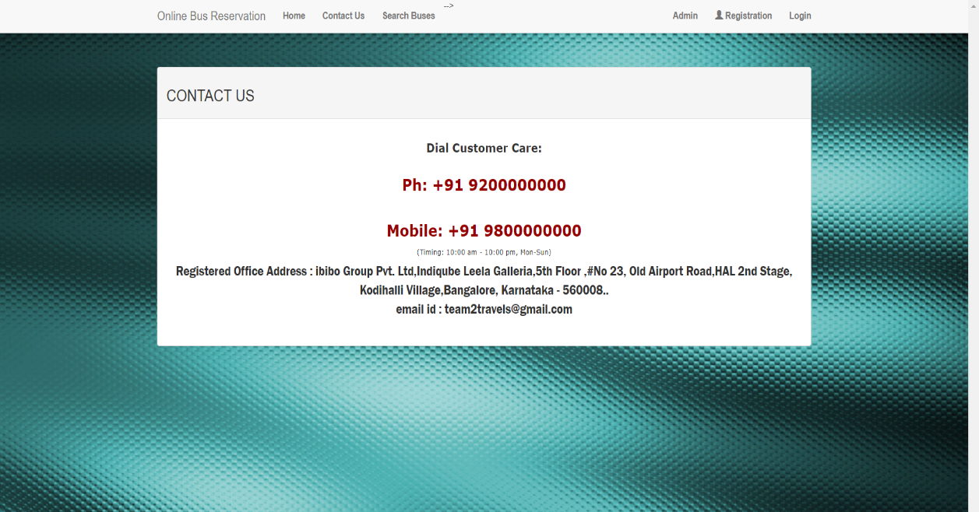
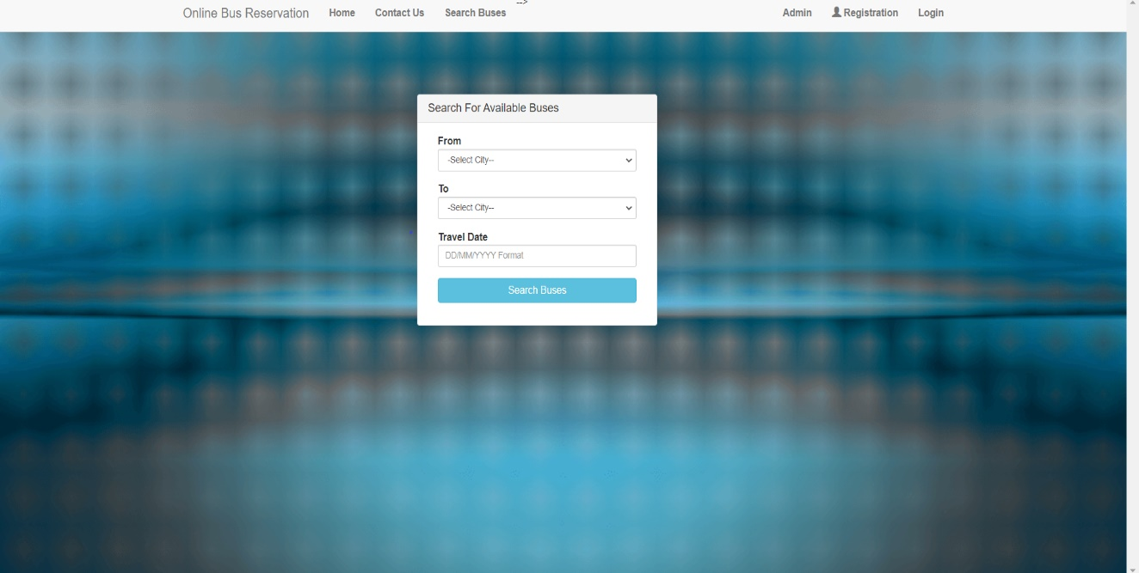
Search Bus:
Contact us page:
From Homepage , we can access to Contact us page

Slide 7
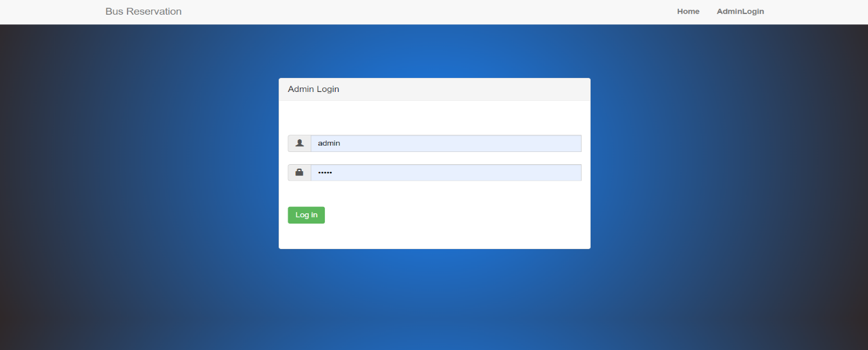
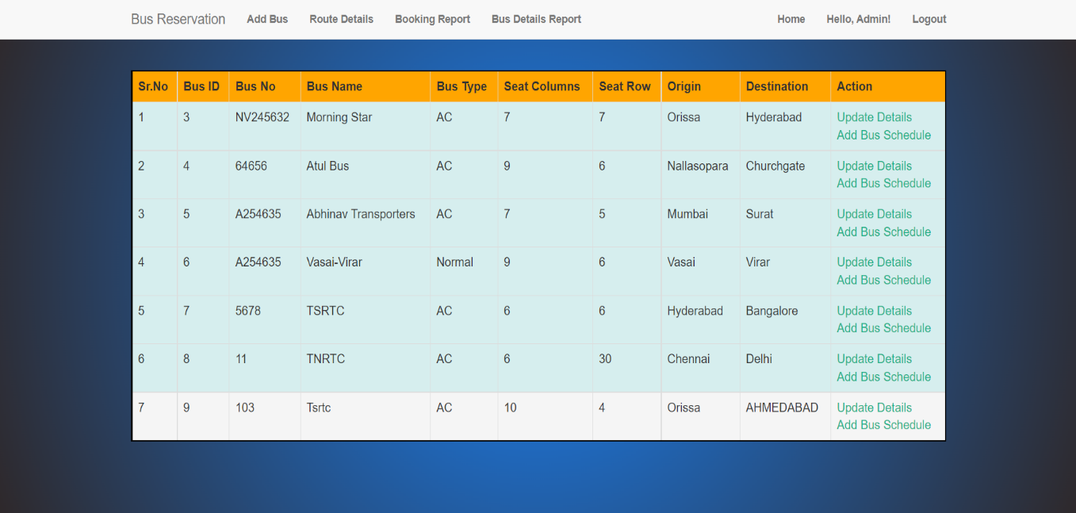
ADMIN MODULE
Admin Login Page :
After the Admin credentials are authorized, the Admin redirected to the Admin homepage.
→ After successful login, Admin will be able to view this bus details.

Slide 8
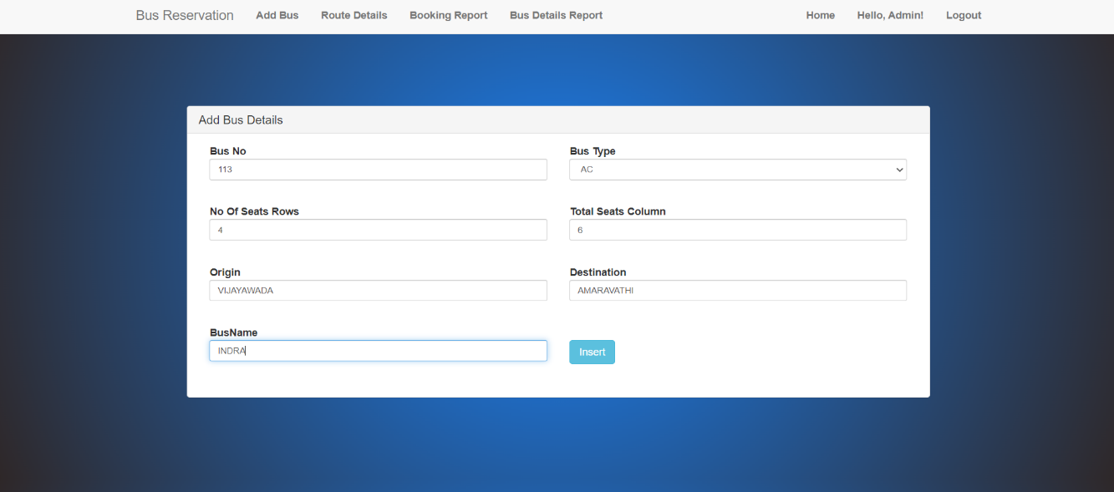
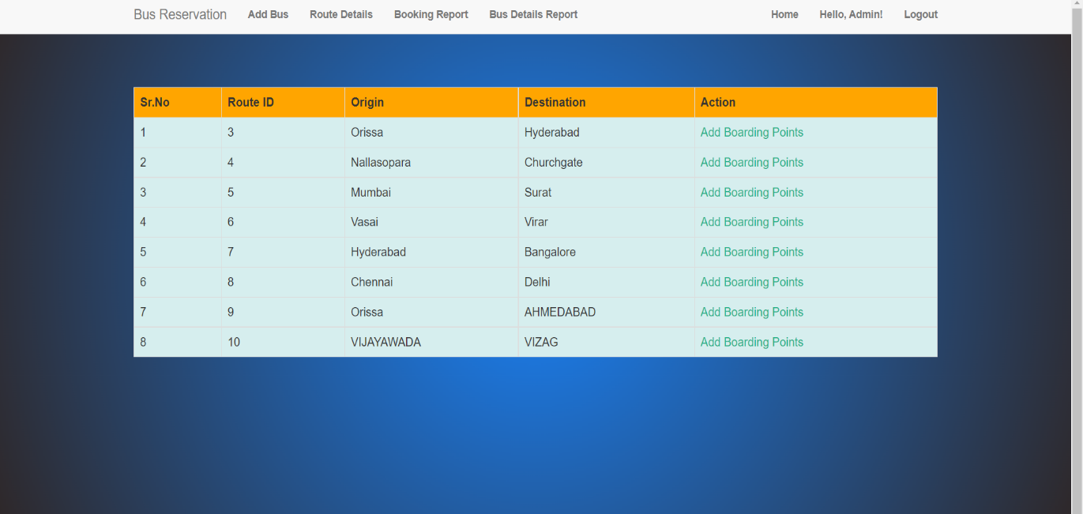
Features of Admin Module
1. ADD BUS
Route Details –
Add Boarding Details

Slide 9
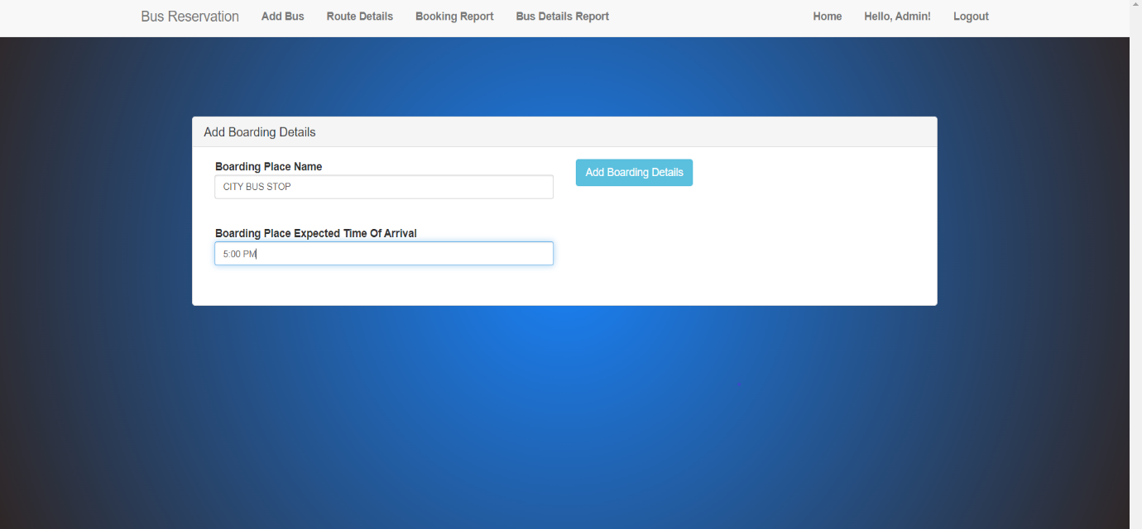
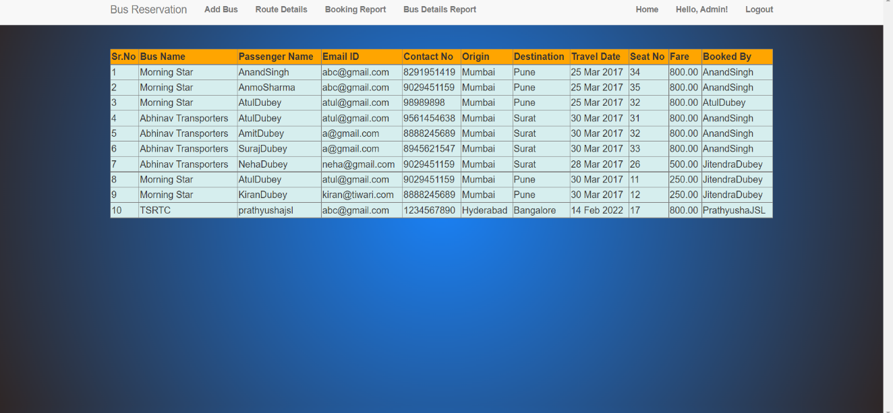
Add Boarding Details ( Continued )
Booking Report

Slide 10
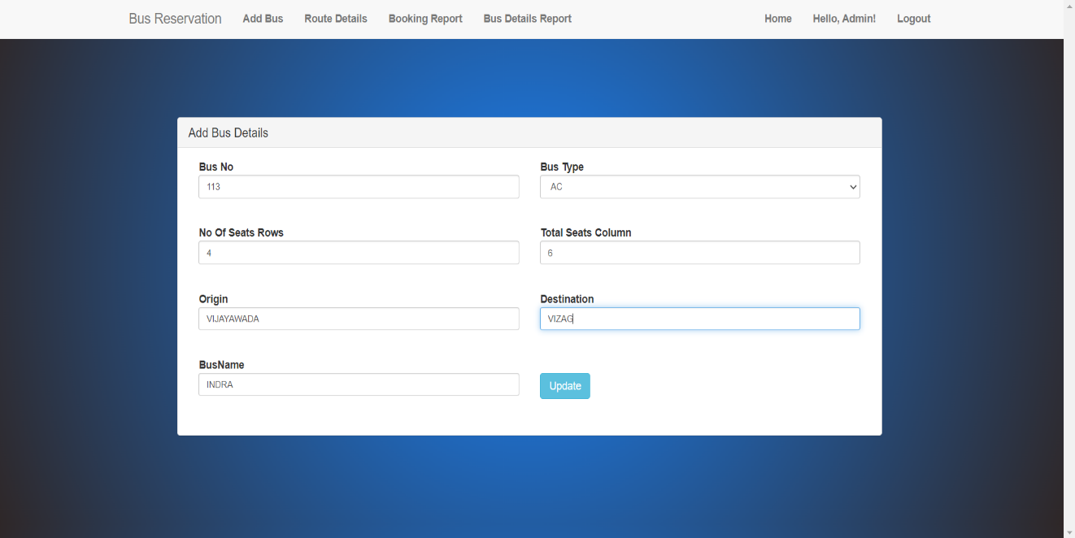
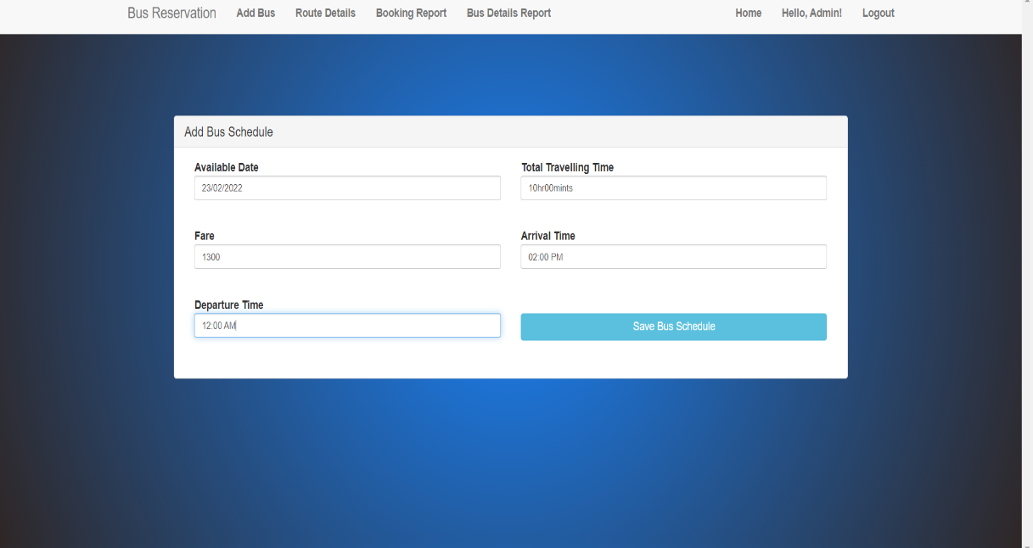
Bus Details Report
1. Update Details
2. Add Bus Schedule

Slide 11
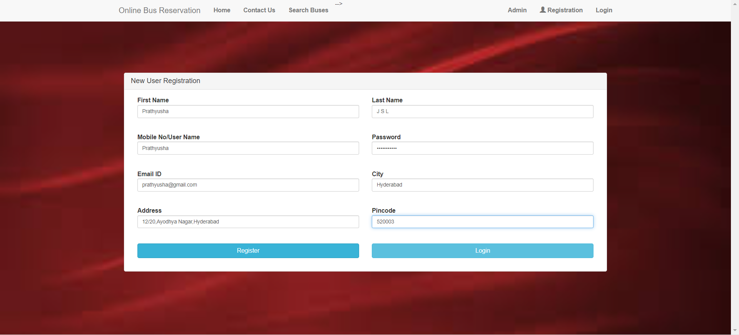
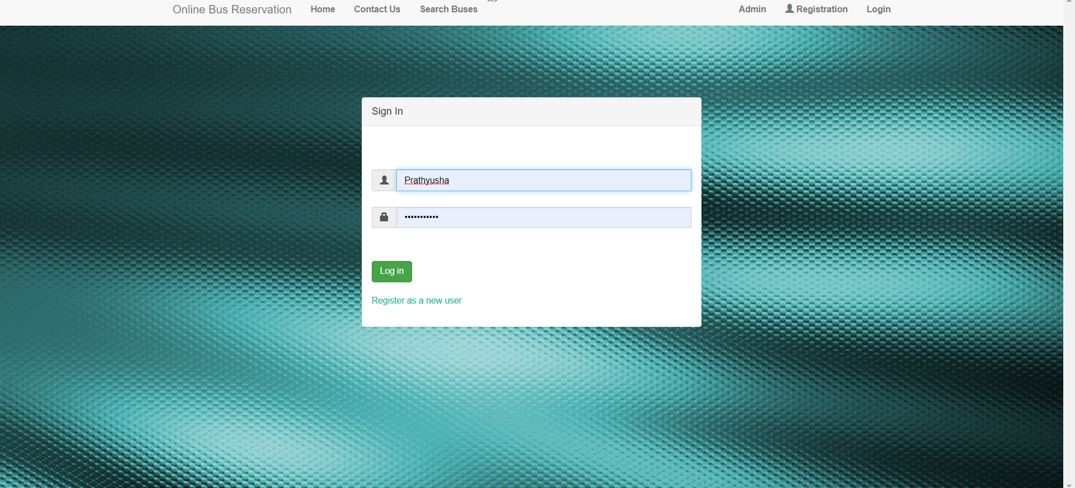
User Module
1. Registration
2. Login

Slide 12
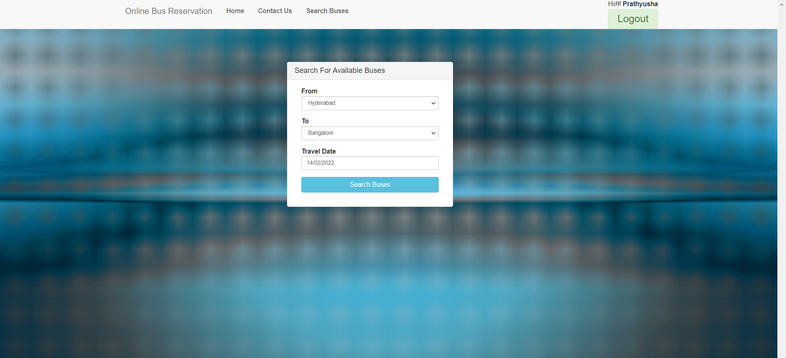
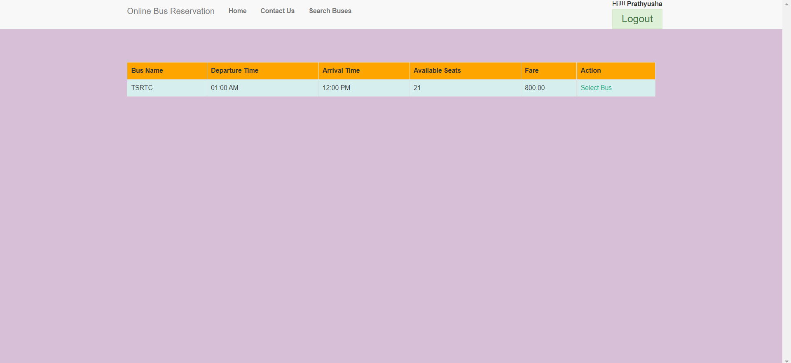
Features of User Module
3.Search Bus
4. Bus Availability

Slide 13
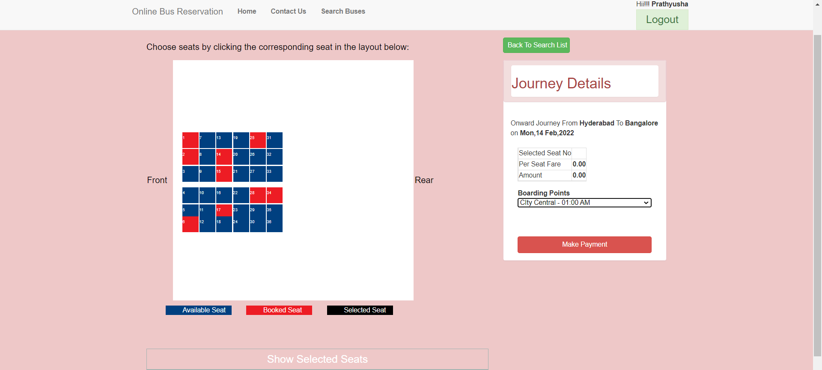
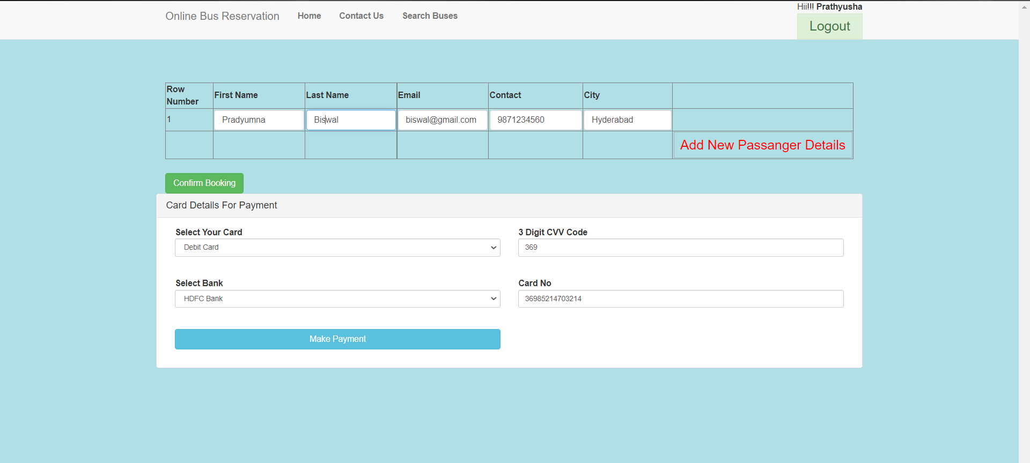
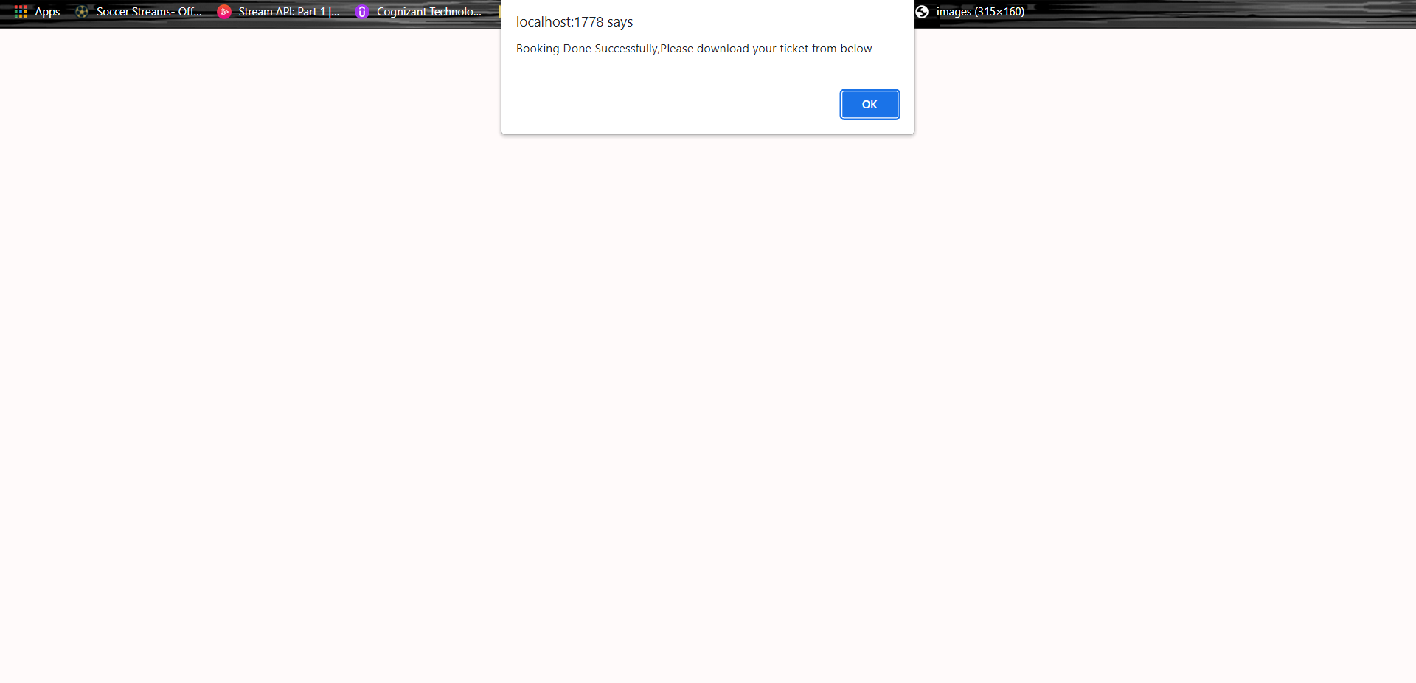
5. Selection of Seats & Boarding point
6. Confirming and Making Payment
7. Booking Completed Message

Slide 14
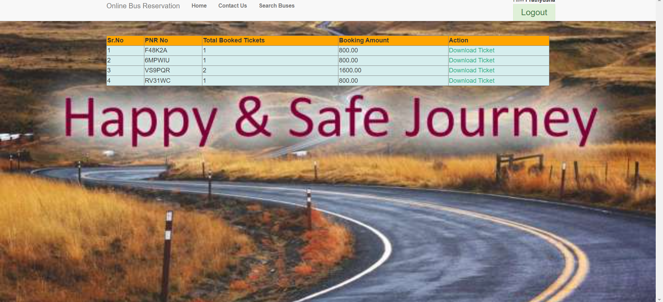
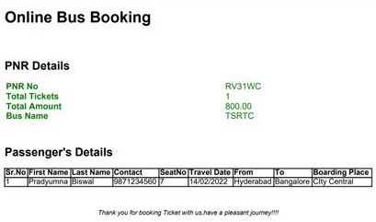
8. Booking Report
9. Downloading the ticket

